Slide 1
03. Dynamic Programming
PAA 2
(Abdul Munif)

Slide 2
Agenda
Dynamic Programming Paradigm
Fibonacci Sequence using DP
Coin Change Problem using DP
Knapsack Problem using DP
Rod Cutting Problem using DP

Slide 3
Dynamic Programming Paradigm

Slide 4
Dynamic Programming (DP)
Solving problems defined by or formulated as recurrence with overlapping sub-instances.

Slide 5
Main Idea of DP
Set up a recurrence relating a problem into smaller problems → divide.
Solve smaller instance once → conquer
Record solutions in a table → memoization
Extract solution to the initial problem from the table

Slide 6
Divide-and-Conquer vs DP
Divide-and-conquer
Dynamic Programing
Divide
Conquer
Combine
Divide
Conquer
Memoization
Combine

Slide 7
Elements of Dynamic Programming
Optimal Substructure
Overlapping sub problems
Reconstructing an optimal solution
Memoization

Slide 8
DP Usage
Discrete optimization problems
Scheduling
String processing
Graph problems
etc.

Slide 9
Fibonacci Sequence using DP

Slide 10
Fibonacci Sequence
F(n) = F(n-1) + F(n-2)
F(0) = 0
F(1) = 1
Computing the n^{th} Fibonacci number recursively (top-down):
F(n)
F(n-1) + F(n-2)
F(n-2) + F(n-3) F(n-3) + F(n-4)
...

Slide 11
Fibonacci Sequence
F(n) = F(n-1) + F(n-2)
F(0) = 0
F(1) = 1
Computing the n^{th} Fibonacci number recursively (top-down):
F(n)
F(n-1) + F(n-2)
F(n-2) + F(n-3) F(n-3) + F(n-4)
...
Recurring solution
T(n) = n log n

Slide 12
Fibonacci Sequence (DP)
F(0) = 0
F(1) = 1
F(2) = 1+0 = 1
…
F(n-2) =
F(n-1) =
F(n) = F(n-1) + F(n-2)
0 | 1 | 1 | 2 | … | F(n-2) | F(n-1) | F(n)
0 | 1 | 2 | 3 | … | n-2 | n-1 | n
T(n) = n

Slide 13
Coin Change Problem

Slide 14
Coin Change Problem
Given a set of coin S (S₁, S₂, …, S_{k}), S₁ < S₂ < … < S_{k} find the minimum coin used for changing money n.

Slide 15
Coin Change Problem
Greedy approach
Use the highest valued coin first
Sometimes it is not the optimal solutions.
Example:
S = {1, 2, 5} → n = 10. Coin used: 2
S = {1, 2, 5, 6} → n = 10. Coin used: 3

Slide 16
Coin Change Problem (DP)
Dynamic Programming approach
Find the recurrence/overlapping problems
Solve the recurrence
Save the result in the memo table.

Slide 17

Coin Change Problem

Slide 18
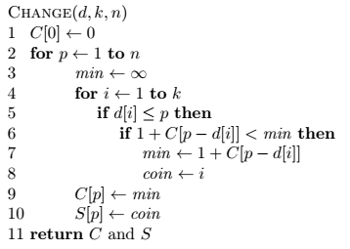
Coin Change Problem (DP)
Solve the recurrence

Slide 19
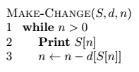
Coin Change Problem (DP)
Find the coin used

Slide 20
Knapsack Problem using DP

Slide 21
Knapsack problem
Given some items, pack the knapsack to get
the maximum total value. Each item has some
weight and some value. Total weight that we can
carry is no more than some fixed number W.
So we must consider weights of items as well as
their values.
Item # Weight Value
1 1 8
2 3 6
3 5 5

Slide 22
Knapsack problem
There are two versions of the problem:
“0-1 knapsack problem”
Items are indivisible; you either take an item or not. Some special instances can be solved with dynamic programming
“Fractional knapsack problem”
Items are divisible: you can take any fraction of an item

Slide 23
0-1 Knapsack problem
Given a knapsack with maximum capacity W, and a set S consisting of n items
Each item i has some weight w_{i} and benefit value b_{i} (all w_{i} and W are integer values)
Problem: How to pack the knapsack to achieve maximum total value of packed items?

Slide 24
0-1 Knapsack problem
Problem, in other words, is to find
The problem is called a “0-1” problem, because each item must be entirely accepted or rejected.

Slide 25
0-1 Knapsack problem: brute-force approach
Let’s first solve this problem with a straightforward algorithm
Since there are n items, there are 2^{n} possible combinations of items.
We go through all combinations and find the one with maximum value and with total weight less or equal to W
Running time will be O(2^{n})

Slide 26
0-1 Knapsack problem: DP
We can do better with an algorithm based on dynamic programming
We need to carefully identify the subproblems

Slide 27
Defining a Subproblem
Given a knapsack with maximum capacity W, and a set S consisting of n items
Each item i has some weight w_{i} and benefit value b_{i} (all w_{i} and W are integer values)
Problem: How to pack the knapsack to achieve maximum total value of packed items?

Slide 28
Defining a Subproblem
We can do better with an algorithm based on dynamic programming
We need to carefully identify the subproblems
Let’s try this:
If items are labeled 1..n, then a subproblem
would be to find an optimal solution for
S_{k} = {items labeled 1, 2, .. k}

Slide 29
Defining a Subproblem
If items are labeled 1..n, then a subproblem would be to find an optimal solution for S_{k} = {items labeled 1, 2, .. k}
This is a reasonable subproblem definition.
The question is: can we describe the final solution (S_{n} ) in terms of subproblems (S_{k})?
Unfortunately, we can’t do that.

Slide 30
Defining a Subproblem
w₁ =2
b₁ =3
w₂ =4
b₂ =5
w₃ =5
b₃ =8
w₄ =3
b₄ =4
Weight
Benefit
Item
#
w_{i}
b_{i}
?
1
2
3
Max weight: W = 20
For S₄:
Total weight: 14
Maximum benefit: 20
S₄
2
4
5
S₅
3
5
8
4
3
4
5
9
10
w₁ =2
b₁ =3
w₂ =4
b₂ =5
w₃ =5
b₃ =8
w₅ =9
b₅ =10
Solution for S₄ is not part of the solution for S₅!!!
For S₅:
Total weight: 20
Maximum benefit: 26

Slide 31
Defining a Subproblem
As we have seen, the solution for S₄ is not part of the solution for S₅
So our definition of a subproblem is flawed and we need another one!

Slide 32
Defining a Subproblem
Given a knapsack with maximum capacity W, and a set S consisting of n items
Each item i has some weight w_{i} and benefit value b_{i} (all w_{i} and W are integer values)
Problem: How to pack the knapsack to achieve maximum total value of packed items?

Slide 33
Defining a Subproblem
Let’s add another parameter: w, which will represent the maximum weight for each subset of items
The subproblem then will be to compute V[k,w], i.e., to find an optimal solution for S_{k} = {items labeled 1, 2, .. k} in a knapsack of size w

Slide 34
Recursive Formula for subproblems
The subproblem will then be to compute V[k,w], i.e., to find an optimal solution for S_{k} = {items labeled 1, 2, .. k} in a knapsack of size w
Assuming knowing V[i, j], where i=0,1, 2, … k-1, j=0,1,2, …w, how to derive V[k,w]?

Slide 35
Recursive Formula for subproblems (continued)
Recursive formula for subproblems:
It means, that the best subset of S_{k} that has total weight w is:
1) the best subset of S_{k-1} that has total weight ≤ w, or
2) the best subset of S_{k-1} that has total weight ≤ w-w_{k} plus the item k

Slide 36
Recursive Formula
The best subset of S_{k} that has the total weight ≤ w, either contains item k or not.
First case: w_{k}>w. Item k can’t be part of the solution, since if it was, the total weight would be > w, which is unacceptable.
Second case: w_{k} ≤ w. Then the item k can be in the solution, and we choose the case with greater value.

Slide 37
0-1 Knapsack Algorithm
for w = 0 to W
V[0,w] = 0
for i = 1 to n
V[i,0] = 0
for i = 1 to n
for w = 0 to W
if w_{i} <= w // item i can be part of the solution
if b_{i} + V[i-1,w-w_{i}] > V[i-1,w]
V[i,w] = b_{i} + V[i-1,w- w_{i}]
else
V[i,w] = V[i-1,w]
else V[i,w] = V[i-1,w] // w_{i} > w

Slide 38
Running time
for w = 0 to W
V[0,w] = 0
for i = 1 to n
V[i,0] = 0
for i = 1 to n
for w = 0 to W
< the rest of the code >
O(W)
Repeat n times
O(W)
What is the running time of this algorithm?
O(n*W)
Remember that the brute-force algorithm
takes O(2^{n})

Slide 39
Example
Let’s run our algorithm on the
following data:
n = 4 (# of elements)
W = 5 (max weight)
Elements (weight, benefit):
(2,3), (3,4), (4,5), (5,6)

Slide 40
Example (2)
i\W
0
1
2
3
4
5
0
0
0
0
0
0
0
1
2
3
4
for w = 0 to W
V[0,w] = 0

Slide 41
Example (3)
i\W
0
1
2
3
4
5
0
0
0
0
0
0
0
1
0
2
0
3
0
4
0
for i = 1 to n
V[i,0] = 0

Slide 42
Example (4)
Items:
1: (2,3)
2: (3,4)
3: (4,5)
4: (5,6)
i\W
0
1
2
3
4
5
i=1
b_{i}=3
w_{i}=2
w=1
w-w_{i} =-1
0
0
0
0
0
0
0
1
0
0
2
0
3
0
4
0
if w_{i} <= w // item i can be part of the solution
if b_{i} + V[i-1,w-w_{i}] > V[i-1,w]
V[i,w] = b_{i} + V[i-1,w- w_{i}]
else
V[i,w] = V[i-1,w]
else V[i,w] = V[i-1,w] // w_{i} > w

Slide 43
Example (5)
Items:
1: (2,3)
2: (3,4)
3: (4,5)
4: (5,6)
i\W
0
1
2
3
4
5
i=1
b_{i}=3
w_{i}=2
w=2
w-w_{i} =0
0
0
0
0
0
0
0
1
0
0
3
2
0
3
0
4
0
if w_{i} <= w // item i can be part of the solution
if b_{i} + V[i-1,w-w_{i}] > V[i-1,w]
V[i,w] = b_{i} + V[i-1,w- w_{i}]
else
V[i,w] = V[i-1,w]
else V[i,w] = V[i-1,w] // w_{i} > w

Slide 44
Example (6)
Items:
1: (2,3)
2: (3,4)
3: (4,5)
4: (5,6)
i\W
0
1
2
3
4
5
i=1
b_{i}=3
w_{i}=2
w=3
w-w_{i} =1
0
0
0
0
0
0
0
1
0
0
3
3
2
0
3
0
4
0
if w_{i} <= w // item i can be part of the solution
if b_{i} + V[i-1,w-w_{i}] > V[i-1,w]
V[i,w] = b_{i} + V[i-1,w- w_{i}]
else
V[i,w] = V[i-1,w]
else V[i,w] = V[i-1,w] // w_{i} > w

Slide 45
Example (7)
Items:
1: (2,3)
2: (3,4)
3: (4,5)
4: (5,6)
i\W
0
1
2
3
4
5
i=1
b_{i}=3
w_{i}=2
w=4
w-w_{i} =2
0
0
0
0
0
0
0
1
0
0
3
3
3
2
0
3
0
4
0
if w_{i} <= w // item i can be part of the solution
if b_{i} + V[i-1,w-w_{i}] > V[i-1,w]
V[i,w] = b_{i} + V[i-1,w- w_{i}]
else
V[i,w] = V[i-1,w]
else V[i,w] = V[i-1,w] // w_{i} > w

Slide 46
Example (8)
Items:
1: (2,3)
2: (3,4)
3: (4,5)
4: (5,6)
i\W
0
1
2
3
4
5
i=1
b_{i}=3
w_{i}=2
w=5
w-w_{i} =3
0
0
0
0
0
0
0
1
0
0
3
3
3
3
2
0
3
0
4
0
if w_{i} <= w // item i can be part of the solution
if b_{i} + V[i-1,w-w_{i}] > V[i-1,w]
V[i,w] = b_{i} + V[i-1,w- w_{i}]
else
V[i,w] = V[i-1,w]
else V[i,w] = V[i-1,w] // w_{i} > w

Slide 47
Example (9)
Items:
1: (2,3)
2: (3,4)
3: (4,5)
4: (5,6)
i\W
0
1
2
3
4
5
i=2
b_{i}=4
w_{i}=3
w=1
w-w_{i} =-2
0
0
0
0
0
0
0
1
0
0
3
3
3
3
2
0
0
3
0
4
0
if w_{i} <= w // item i can be part of the solution
if b_{i} + V[i-1,w-w_{i}] > V[i-1,w]
V[i,w] = b_{i} + V[i-1,w- w_{i}]
else
V[i,w] = V[i-1,w]
else V[i,w] = V[i-1,w] // w_{i} > w

Slide 48
Example (10)
Items:
1: (2,3)
2: (3,4)
3: (4,5)
4: (5,6)
i\W
0
1
2
3
4
5
i=2
b_{i}=4
w_{i}=3
w=2
w-w_{i} =-1
0
0
0
0
0
0
0
1
0
0
3
3
3
3
2
0
0
3
3
0
4
0
if w_{i} <= w // item i can be part of the solution
if b_{i} + V[i-1,w-w_{i}] > V[i-1,w]
V[i,w] = b_{i} + V[i-1,w- w_{i}]
else
V[i,w] = V[i-1,w]
else V[i,w] = V[i-1,w] // w_{i} > w

Slide 49
Example (11)
Items:
1: (2,3)
2: (3,4)
3: (4,5)
4: (5,6)
i\W
0
1
2
3
4
5
i=2
b_{i}=4
w_{i}=3
w=3
w-w_{i} =0
0
0
0
0
0
0
0
1
0
0
3
3
3
3
2
0
0
3
4
3
0
4
0
if w_{i} <= w // item i can be part of the solution
if b_{i} + V[i-1,w-w_{i}] > V[i-1,w]
V[i,w] = b_{i} + V[i-1,w- w_{i}]
else
V[i,w] = V[i-1,w]
else V[i,w] = V[i-1,w] // w_{i} > w

Slide 50
Example (12)
Items:
1: (2,3)
2: (3,4)
3: (4,5)
4: (5,6)
i\W
0
1
2
3
4
5
i=2
b_{i}=4
w_{i}=3
w=4
w-w_{i} =1
0
0
0
0
0
0
0
1
0
0
3
3
3
3
2
0
0
3
4
4
3
0
4
0
if w_{i} <= w // item i can be part of the solution
if b_{i} + V[i-1,w-w_{i}] > V[i-1,w]
V[i,w] = b_{i} + V[i-1,w- w_{i}]
else
V[i,w] = V[i-1,w]
else V[i,w] = V[i-1,w] // w_{i} > w

Slide 51
Example (13)
Items:
1: (2,3)
2: (3,4)
3: (4,5)
4: (5,6)
i\W
0
1
2
3
4
5
i=2
b_{i}=4
w_{i}=3
w=5
w-w_{i} =2
0
0
0
0
0
0
0
1
0
0
3
3
3
3
2
0
0
3
4
4
7
3
0
4
0
if w_{i} <= w // item i can be part of the solution
if b_{i} + V[i-1,w-w_{i}] > V[i-1,w]
V[i,w] = b_{i} + V[i-1,w- w_{i}]
else
V[i,w] = V[i-1,w]
else V[i,w] = V[i-1,w] // w_{i} > w

Slide 52
Example (14)
Items:
1: (2,3)
2: (3,4)
3: (4,5)
4: (5,6)
i\W
0
1
2
3
4
5
i=3
b_{i}=5
w_{i}=4
w= 1..3
0
0
0
0
0
0
0
1
0
0
3
3
3
3
2
0
0
3
4
4
7
3
0
0
3
4
4
0
if w_{i} <= w // item i can be part of the solution
if b_{i} + V[i-1,w-w_{i}] > V[i-1,w]
V[i,w] = b_{i} + V[i-1,w- w_{i}]
else
V[i,w] = V[i-1,w]
else V[i,w] = V[i-1,w] // w_{i} > w

Slide 53
Example (15)
Items:
1: (2,3)
2: (3,4)
3: (4,5)
4: (5,6)
i\W
0
1
2
3
4
5
i=3
b_{i}=5
w_{i}=4
w= 4
w- w_{i}=0
0
0
0
0
0
0
0
1
0
0
3
3
3
3
2
0
0
3
4
4
7
3
0
0
3
4
5
4
0
if w_{i} <= w // item i can be part of the solution
if b_{i} + V[i-1,w-w_{i}] > V[i-1,w]
V[i,w] = b_{i} + V[i-1,w- w_{i}]
else
V[i,w] = V[i-1,w]
else V[i,w] = V[i-1,w] // w_{i} > w

Slide 54
Example (16)
Items:
1: (2,3)
2: (3,4)
3: (4,5)
4: (5,6)
i\W
0
1
2
3
4
5
i=3
b_{i}=5
w_{i}=4
w= 5
w- w_{i}=1
0
0
0
0
0
0
0
1
0
0
3
3
3
3
2
0
0
3
4
4
7
3
0
0
3
4
5
7
4
0
if w_{i} <= w // item i can be part of the solution
if b_{i} + V[i-1,w-w_{i}] > V[i-1,w]
V[i,w] = b_{i} + V[i-1,w- w_{i}]
else
V[i,w] = V[i-1,w]
else V[i,w] = V[i-1,w] // w_{i} > w

Slide 55
Example (17)
Items:
1: (2,3)
2: (3,4)
3: (4,5)
4: (5,6)
i\W
0
1
2
3
4
5
i=4
b_{i}=6
w_{i}=5
w= 1..4
0
0
0
0
0
0
0
1
0
0
3
3
3
3
2
0
0
3
4
4
7
3
0
0
3
4
5
7
4
0
0
3
4
5
if w_{i} <= w // item i can be part of the solution
if b_{i} + V[i-1,w-w_{i}] > V[i-1,w]
V[i,w] = b_{i} + V[i-1,w- w_{i}]
else
V[i,w] = V[i-1,w]
else V[i,w] = V[i-1,w] // w_{i} > w

Slide 56
Example (18)
Items:
1: (2,3)
2: (3,4)
3: (4,5)
4: (5,6)
i\W
0
1
2
3
4
5
i=4
b_{i}=6
w_{i}=5
w= 5
w- w_{i}=0
0
0
0
0
0
0
0
1
0
0
3
3
3
3
2
0
0
3
4
4
7
3
0
0
3
4
5
7
4
0
0
3
4
5
7
if w_{i} <= w // item i can be part of the solution
if b_{i} + V[i-1,w-w_{i}] > V[i-1,w]
V[i,w] = b_{i} + V[i-1,w- w_{i}]
else
V[i,w] = V[i-1,w]
else V[i,w] = V[i-1,w] // w_{i} > w

Slide 57
Exercise
Apply the bottom-up dynamic programming algorithm to the following instance of the knapsack problem. The total capacity W = 6.
How to find out which items are in the optimal subset?
Item | Weight | Value
1 | 3 | $25
2 | 2 | $20
3 | 1 | $15
4 | 4 | $40
5 | 5 | $50

Slide 58
Comments
This algorithm only finds the max possible value that can be carried in the knapsack
i.e., the value in V[n,W]
To know the items that make this maximum value, an addition to this algorithm is necessary

Slide 59
How to find actual Knapsack Items
All of the information we need is in the table.
V[n,W] is the maximal value of items that can be placed in the Knapsack.
Let i=n and k=W
if V[i,k] ≠ V[i−1,k] then
mark the i^{th} item as in the knapsack
i = i−1, k = k-w_{i}
else
i = i−1 // Assume the i^{th} item is not in the knapsack
// Could it be in the optimally packed knapsack?

Slide 60
Finding the Items
Items:
1: (2,3)
2: (3,4)
3: (4,5)
4: (5,6)
i\W
0
1
2
3
4
5
i=4
k= 5
b_{i}=6
w_{i}=5
V[i,k] = 7
V[i−1,k] =7
0
0
0
0
0
0
0
1
0
0
3
3
3
3
2
0
0
3
4
4
7
3
0
0
3
4
5
7
4
0
0
3
4
5
7
i=n, k=W
while i,k > 0
if V[i,k] ≠ V[i−1,k] then
mark the i^{th} item as in the knapsack
i = i−1, k = k-w_{i}
else
i = i−1

Slide 61
Finding the Items (2)
Items:
1: (2,3)
2: (3,4)
3: (4,5)
4: (5,6)
i\W
0
1
2
3
4
5
i=4
k= 5
b_{i}=6
w_{i}=5
V[i,k] = 7
V[i−1,k] =7
0
0
0
0
0
0
0
1
0
0
3
3
3
3
2
0
0
3
4
4
7
3
0
0
3
4
5
7
4
0
0
3
4
5
7
i=n, k=W
while i,k > 0
if V[i,k] ≠ V[i−1,k] then
mark the i^{th} item as in the knapsack
i = i−1, k = k-w_{i}
else
i = i−1

Slide 62
Finding the Items (3)
Items:
1: (2,3)
2: (3,4)
3: (4,5)
4: (5,6)
i\W
0
1
2
3
4
5
i=3
k= 5
b_{i}=5
w_{i}=4
V[i,k] = 7
V[i−1,k] =7
0
0
0
0
0
0
0
1
0
0
3
3
3
3
2
0
0
3
4
4
7
3
0
0
3
4
5
7
4
0
0
3
4
5
7
i=n, k=W
while i,k > 0
if V[i,k] ≠ V[i−1,k] then
mark the i^{th} item as in the knapsack
i = i−1, k = k-w_{i}
else
i = i−1

Slide 63
Finding the Items (4)
Items:
1: (2,3)
2: (3,4)
3: (4,5)
4: (5,6)
i\W
0
1
2
3
4
5
i=2
k= 5
b_{i}=4
w_{i}=3
V[i,k] = 7
V[i−1,k] =3
k − w_{i}=2
0
0
0
0
0
0
0
1
0
0
3
3
3
3
2
0
0
3
4
4
7
7
3
0
0
3
4
5
7
4
0
0
3
4
5
7
i=n, k=W
while i,k > 0
if V[i,k] ≠ V[i−1,k] then
mark the i^{th} item as in the knapsack
i = i−1, k = k-w_{i}
else
i = i−1

Slide 64
Finding the Items (5)
Items:
1: (2,3)
2: (3,4)
3: (4,5)
4: (5,6)
i\W
0
1
2
3
4
5
i=1
k= 2
b_{i}=3
w_{i}=2
V[i,k] = 3
V[i−1,k] =0
k − w_{i}=0
0
0
0
0
0
0
0
1
0
0
3
3
3
3
3
2
0
0
3
4
4
7
3
0
0
3
4
5
7
4
0
0
3
4
5
7
i=n, k=W
while i,k > 0
if V[i,k] ≠ V[i−1,k] then
mark the i^{th} item as in the knapsack
i = i−1, k = k-w_{i}
else
i = i−1

Slide 65
Finding the Items (6)
Items:
1: (2,3)
2: (3,4)
3: (4,5)
4: (5,6)
i\W
0
1
2
3
4
5
i=0
k= 0
0
0
0
0
0
0
0
1
0
0
3
3
3
3
2
0
0
3
4
4
7
3
0
0
3
4
5
7
The optimal knapsack should contain {1, 2}
4
0
0
3
4
5
7
i=n, k=W
while i,k > 0
if V[i,k] ≠ V[i−1,k] then
mark the n^{th} item as in the knapsack
i = i−1, k = k-w_{i}
else
i = i−1

Slide 66
Finding the Items (7)
Items:
1: (2,3)
2: (3,4)
3: (4,5)
4: (5,6)
i\W
0
1
2
3
4
5
0
0
0
0
0
0
0
1
0
0
3
3
3
3
3
2
0
0
3
4
4
7
7
3
0
0
3
4
5
7
The optimal knapsack should contain {1, 2}
4
0
0
3
4
5
7
i=n, k=W
while i,k > 0
if V[i,k] ≠ V[i−1,k] then
mark the n^{th} item as in the knapsack
i = i−1, k = k-w_{i}
else
i = i−1

Slide 67
Memorization (Memory Function Method)
Goal:
Solve only subproblems that are necessary and solve it only once
Memorization is another way to deal with overlapping subproblems in dynamic programming
With memorization, we implement the algorithm recursively:
If we encounter a new subproblem, we compute and store the solution.
If we encounter a subproblem we have seen, we look up the answer
Most useful when the algorithm is easiest to implement recursively
Especially if we do not need solutions to all subproblems.

Slide 68
0-1 Knapsack Memory Function Algorithm
for i = 1 to n
for w = 1 to W
V[i,w] = -1
for w = 0 to W
V[0,w] = 0
for i = 1 to n
V[i,0] = 0
MFKnapsack(i, w)
if V[i,w] < 0
if w < w_{i}
value = MFKnapsack(i-1, w)
else
value = max(MFKnapsack(i-1, w),
b_{i} + MFKnapsack(i-1, w-w_{i}))
V[i,w] = value
return V[i,w]

Slide 69
Conclusion for Knapsack Problem
Dynamic programming is a useful technique of solving certain kind of problems
When the solution can be recursively described in terms of partial solutions, we can store these partial solutions and re-use them as necessary (memorization)
Running time of dynamic programming algorithm vs. naïve algorithm:
0-1 Knapsack problem: O(W*n) vs. O(2^{n})

Slide 70
Example: Rod Cutting (text)
You are given a rod of length n ≥ 0 (n in inches)
A rod of length i inches will be sold for p_{i} dollars
Cutting is free (simplifying assumption)
Problem: given a table of prices p_{i} determine the maximum revenue r_{n} obtainable by cutting up the rod and selling the pieces.
Length i
Price p_{i}
1 | 2 | 3 | 4 | 5 | 6 | 7 | 8 | 9 | 10
1 | 5 | 8 | 9 | 10 | 17 | 17 | 20 | 24 | 30

Slide 71
Example: Rod Cutting
We can see immediately (from the values in the table) that n ≤ p_{n} ≤ 3n.
This is not very useful because:
The range of potential revenue is very large
Our finding quick upper and lower bounds depends on finding quickly the minimum and maximum p_{i}/i ratios (one pass through the table), but then we are back to the point above….

Slide 72
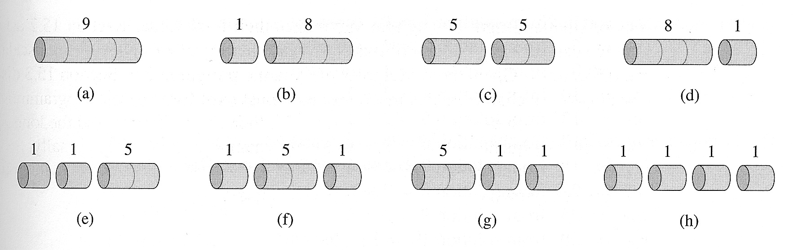
Example: Rod Cutting Step 1: Characterizing an Optimal Solution
Question: in how many different ways can we cut a rod of length n?
For a rod of length 4:
2⁴ ⁻ ¹ = 2³ = 8
For a rod of length n: 2^{n-1}. Exponential: we cannot try all possibilities for n "large". The obvious exhaustive approach won't work.
Notes:
What kind of Notes??

Slide 73
Example: Rod Cutting Step 1: Characterizing an Optimal Solution
Question: in how many different ways can we cut a rod of length n?
Proof Details: a rod of length n can have exactly n-1 possible cut positions – choose 0 ≤ k ≤ n-1 actual cuts. We can choose the k cuts (without repetition) anywhere we want, so that for each such k the number of different choices is
When we sum up over all possibilities (k = 0 to k = n-1):
For a rod of length n: 2^{n-1}.
Notes:
What kind of Notes??

Slide 74
Example: Rod Cutting Characterizing an Optimal Solution
Let us find a way to solve the problem recursively (we might be able to modify the solution so that the maximum can be actually computed): assume we have cut a rod of length n into 0 ≤ k ≤ n pieces of length i₁, …, i_{k},
n = i₁ +…+ i_{k},
with revenue
r_{n} = p_{i1} + … + p_{ik}
Assume further that this solution is optimal.
How can we construct it?
Advice: when you don’t know what to do next, start with a simple example and hope something will occur to you…

Slide 75
Example: Rod Cutting Characterizing an Optimal Solution
Length i
Price p_{i}
1 | 2 | 3 | 4 | 5 | 6 | 7 | 8 | 9 | 10
1 | 5 | 8 | 9 | 10 | 17 | 17 | 20 | 24 | 30
We begin by constructing (by hand) the optimal solutions for i = 1, …, 10:
r₁ = 1 from sln. 1 = 1 (no cuts)
r₂ = 5 from sln. 2 = 2 (no cuts)
r₃ = 8 from sln. 3 = 3 (no cuts)
r₄ = 10 from sln. 4 = 2 + 2
r₅ = 13 from sln. 5 = 2 + 3
r₆ = 17 from sln. 6 = 6 (no cuts)
r₇ = 18 from sln. 7 = 1 + 6 or 7 = 2 + 2 + 3
r₈ = 22 from sln. 8 = 2 + 6
r₉ = 25 from sln. 9 = 3 + 6
r₁₀ = 30 from sln. 10 = 10 (no cuts)

Slide 76
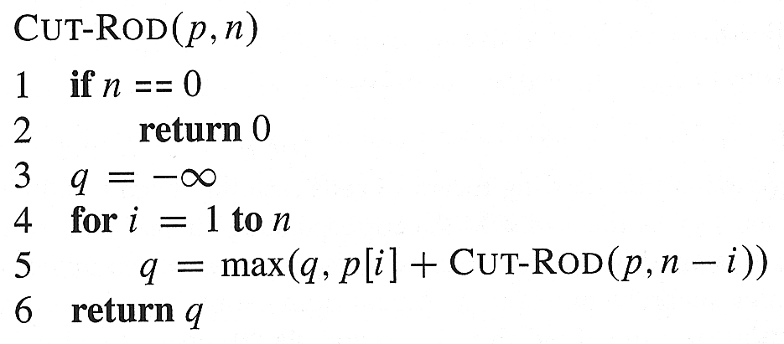
Example: Rod Cutting Characterizing an Optimal Solution
Notice that in some cases r_{n} = p_{n}, while in other cases the optimal revenue r_{n} is obtained by cutting the rod into smaller pieces.
In ALL cases we have the recursion
r_{n} = max(p_{n}, r₁ + r_{n-1}, r₂ + r_{n-2}, …, r_{n-1} + r₁)
exhibiting optimal substructure (meaning?)
A slightly different way of stating the same recursion, which avoids repeating some computations, is
r_{n} = max_{1≤i≤n}(p_{i} + r_{n-i})
And this latter relation can be implemented as a simple top-down recursive procedure:

Slide 77
Example: Rod Cutting Characterizing an Optimal Solution
Time Out: How to justify the step from:
r_{n} = max(p_{n}, r₁ + r_{n-1}, r₂ + r_{n-2}, …, r_{n-1} + r₁)
to
r_{n} = max_{1≤i≤n}(p_{i} + r_{n-i})
Note: every optimal partitioning of a rod of length n has a first cut – a segment of, say, length i. The optimal revenue, r_{n}, must satisfy r_{n} = p_{i} + r_{n-i}, where r_{n-i} is the optimal revenue for a rod of length n – i. If the latter were not the case, there would be a better partitioning for a rod of length n – i, giving a revenue r’_{n–i} > r_{n-i} and a total revenue r’_{n} = p_{n} + r’_{n-i} > p_{i} + r_{n-i} = r_{n}.
Since we do not know which one of the leftmost cut positions provides the largest revenue, we just maximize over all the possible first cut positions.

Slide 78
Example: Rod Cutting Characterizing an Optimal Solution
We can also notice that all the items we choose the maximum of are optimal in their own right: each substructure (max revenue for rods of lengths 1, …, n-1) is also optimal (again, optimal substructure property).
Nevertheless, we are still in trouble: computing the recursion leads to recomputing a number (= overlapping subproblems) of values – how many?

Slide 79
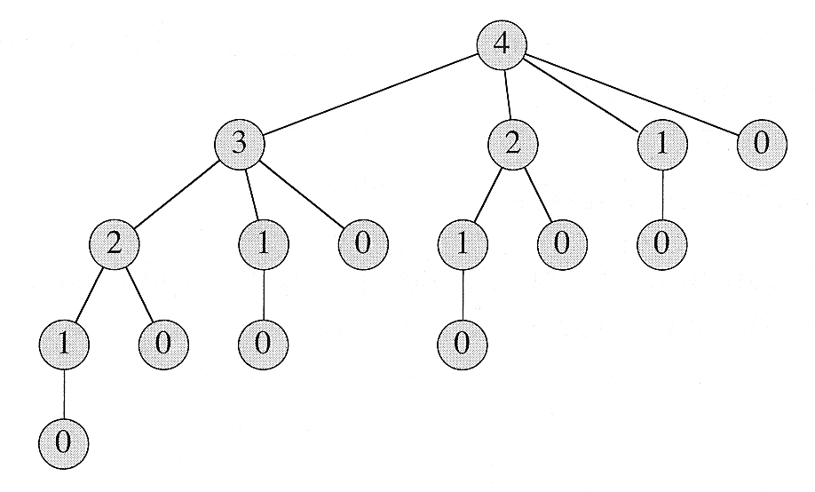
Example: Rod Cutting Characterizing an Optimal Solution
Let’s call Cut-Rod(p, 4), to see the effects on a simple case:
The number of nodes for a tree corresponding to a rod of size n is:

Slide 80
Example: Rod Cutting Beyond Naïve Time Complexity
We have a problem: “reasonable size” problems are not solvable in “reasonable time” (but, in this case, they are solvable in “reasonable space”).
Specifically:
Note that navigating the whole tree requires 2^{n} stack-frame activations.
Note also that no more than n + 1 stack-frames are active at any one time and that no more than n + 1 different values need to be computed or used.
Can we exploit these observations?
A standard solution method involves saving the values associated with each T(j), so that we compute each value only once (called “memoizing” = writing yourself a memo).

Slide 81
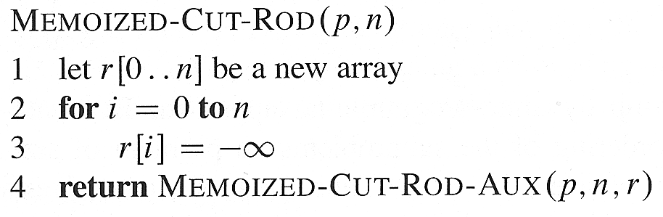
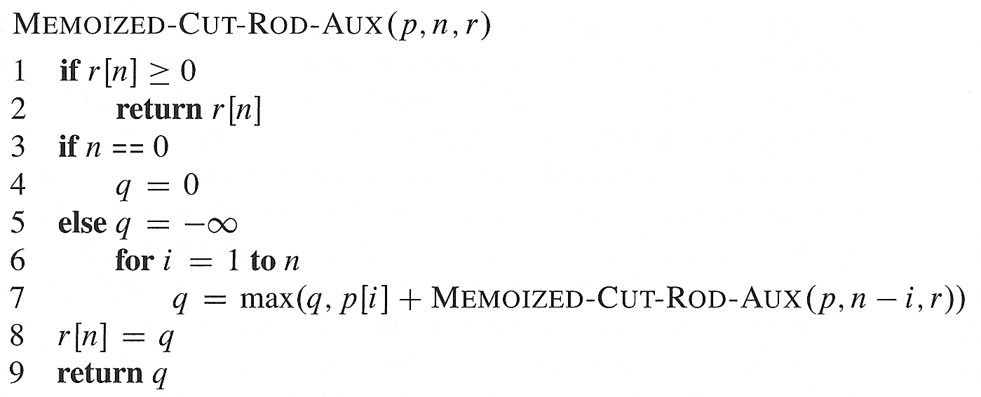
Example: Rod Cutting Naïve Caching
We introduce two procedures:

Slide 82
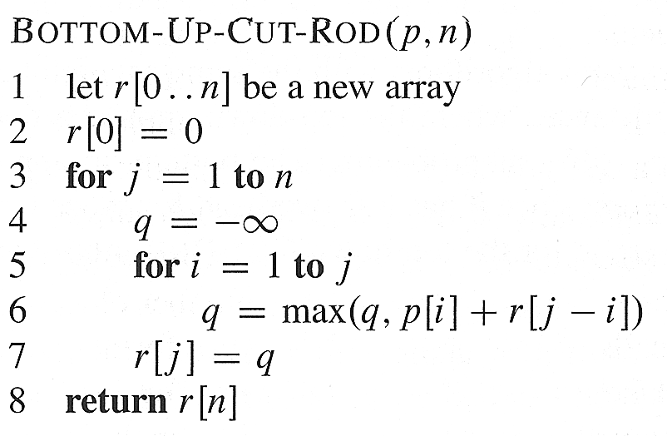
Example: Rod Cutting More Sophisticated Caching
We now remove some unnecessary complications:

Slide 83
Example: Rod Cutting Time Complexity
Whether we solve the problem in a top-down or bottom-up manner the asymptotic time is Θ(n²), the major difference being recursive calls as compared to loop iterations.
Why??

